Slide 1


Fighting Cybercrime using Digital Forensics

Slide 2
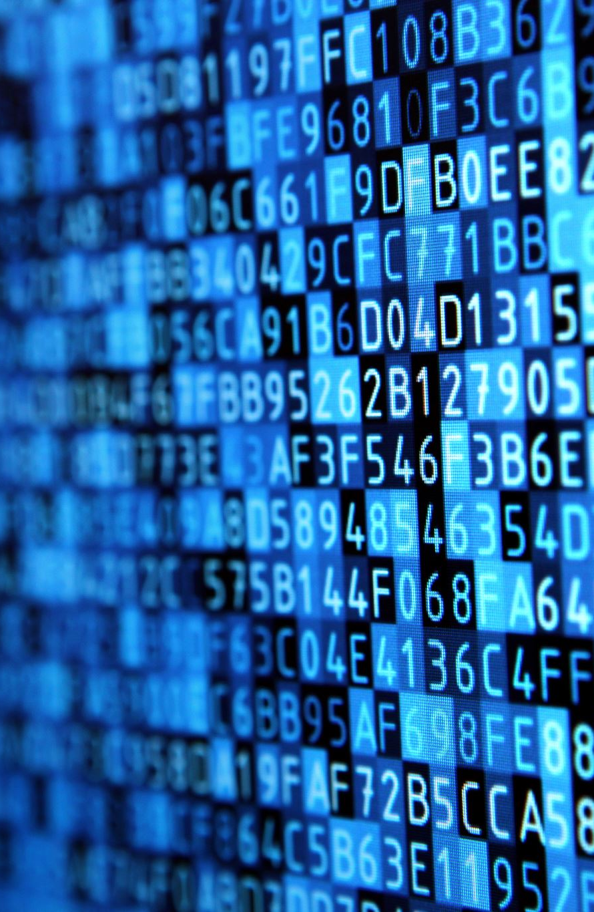
Session Outline
Digital Forensics:
Types of digital forensics
Forensic processes
Investigative Mindset
Analysis of a suspect disk image
Tools for this session:
Autopsy for Windows
Hunter XP demo case

Slide 3
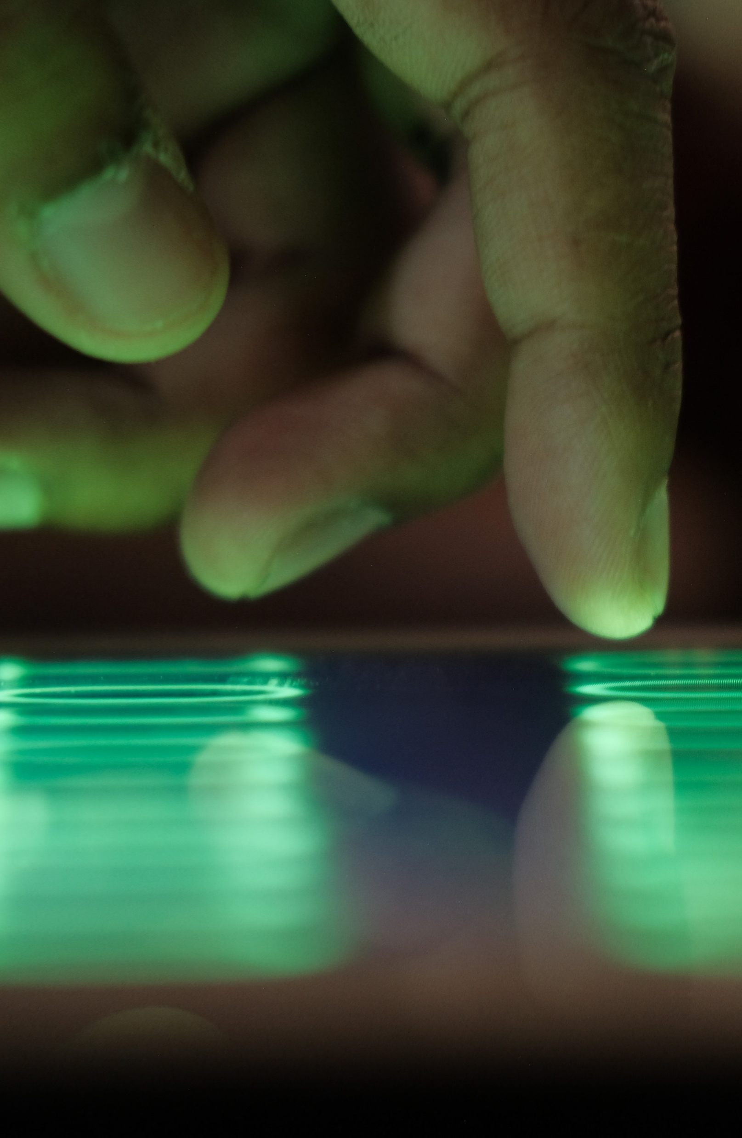
What is Cybercrime?
The UK Government defines Cybercrime as:
Cyber-dependent crimes - crimes that can be committed only through the use of Information and Communications Technology (‘ICT’) devices, where the devices are both the tool for committing the crime, and the target of the crime (e.g. developing and propagating malware for financial gain, hacking to steal, damage, distort or destroy data and/or network or activity).
Cyber-enabled crimes - traditional crimes which can be increased in scale or reach by the use of computers, computer networks or other forms of ICT (such as cyber-enabled fraud and data theft).
Source: https://www.cps.gov.uk/legal-guidance/cybercrime-prosecution-guidance

Slide 4

How do we deal with Cybercrime?
Digital Forensic Investigation
“The use of scientifically derived and proven methods toward the preservation, collection, validation, identification, analysis, interpretation, documentation and presentation of digital evidence derived from digital sources for the purpose of facilitating or furthering the reconstruction of events found to be criminal or helping to anticipate unauthorized actions shown to be disruptive to planned operations.”
Source: Digital Forensic Research Workshop (DFRWS), 2001

Slide 5
Forensic Process
Identification
Locate evidence.
Preservation
Isolate, secure and preserve data
Examination & Analysis
Examine data and draw conclusions
Create a record of findings
Documentation
Presentation
Summarize findings and draw conclusions.
Source: https://www.eccouncil.org/cybersecurity/what-is-digital-forensics/

Slide 6

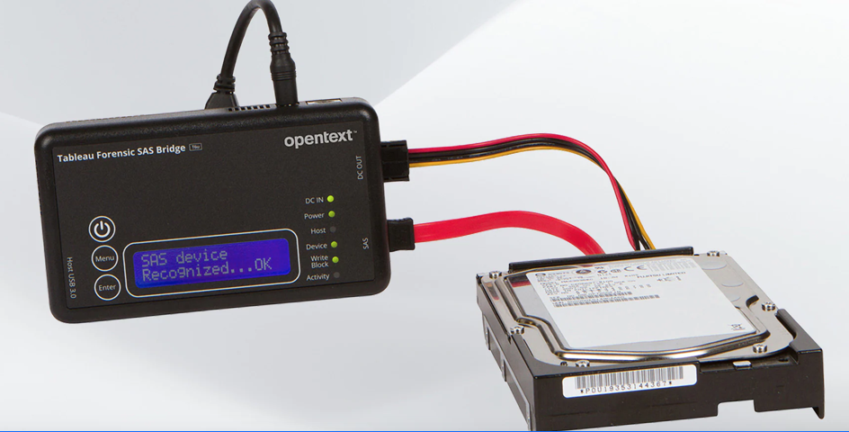
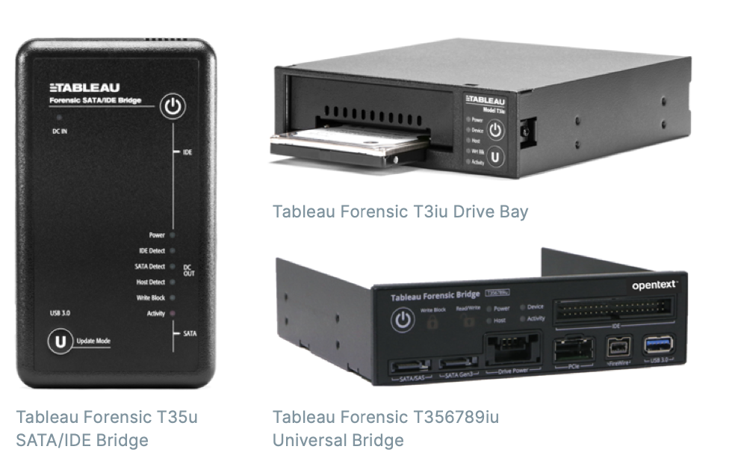
Acquisition
Preservation of data is essential
Cloning suspect hard drive to an image file
Hardware write blocker
Ensure that no new data is written to a suspect drive
Documentation and chain of custody
Written records of each process followed and who carried out tasks involved.

Slide 7
Forensic Analysis
Dead analysis
Examination of the suspect machine in a non-booted fashion.
Use of case management software.
Conducting operations on the suspect image or drive without modification.
Live analysis
Examination of the suspects machine in a booted fashion.
Use of a write-blocker to prevent contamination of evidence.
Useful for understanding how a piece of malware is behaving.

Slide 8
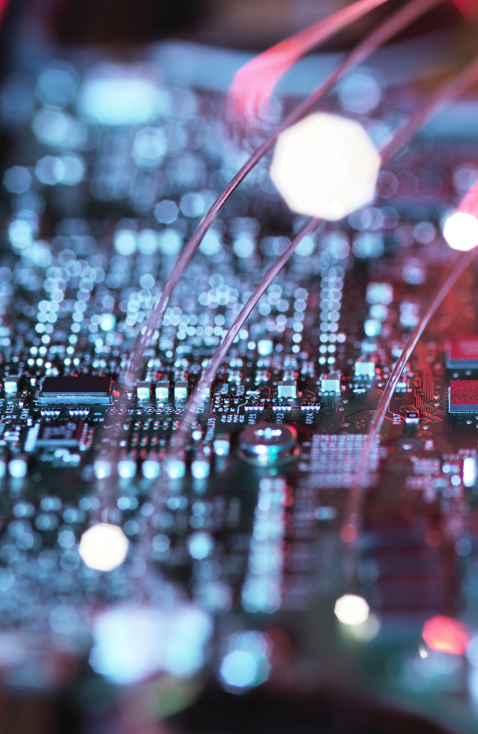
OS & File Systems
Depending on the operating system, likely to encounter different file systems. The file system manages the way that data is indexed on the hard drive.
Microsoft Windows:
FAT (File Allocation Table):
Older file system used by older versions of windows.
Usually 12bit ,16bit or 32bit.
NTFS (New technology file system):
Modern file system that supports additional features such as encryption.
Mac OS:
HFS (Hierarchical file system).
Typically used by older macOS devices.
APFS (Apple file system).
Newer file system introduced by Apple for their macOS and iOS devices.
Linux & Unix:
Ext (Extended file system).

Slide 9
Applications
When searching for evidence, it’s worth considering which applications might provide the most insight into potential suspect activity.
Email clients:
MS Outlook, Mozilla Thunderbird, Apple Mail.
Email accounts, email communications and attachments.
Instant messaging apps:
Discord, Signal, WhatsApp.
Chat logs and chat attachments.
File sharing or storage apps:
Dropbox, Google Drive, OneDrive.
Internet browsers:
Browsing history, social media activity or communications.
Multimedia applications:
Media players and media editing software.
Images, video files etc.

Slide 10
Investigative Mindset
A set of attitudes, approaches and skills that a digital forensic examiner adopts to effectively analyze digital evidence.
Attention to detail:
Small details may be important, file timestamps, system logs and meta data could be easily missed.
Critical thinking:
Challenging assumptions, forming hypotheses and evaluating evidence.
Effective communication:
Capable of communicating findings in a court of law.
Legal & ethical awareness:
Aware of the legal and ethical implications of digital forensic investigation, adhering to set standards and respecting the chain of custody.
Objectivity:
Conducting analysis based on factual evidence discovery, setting aside personal opinion or bias.

Slide 11
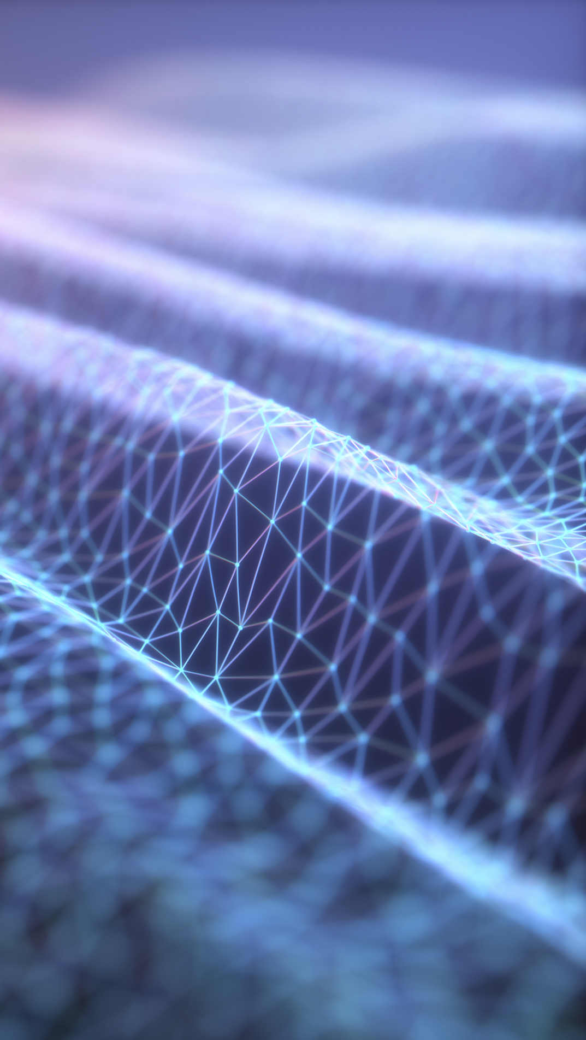
Activity: Autopsy
Open Autopsy 4.20.0
Add a new case.
Enter a name for your case and select a base directory, such as in your documents area.
Select Host: Generate new host name based on data source.
Import the ‘Hunter XP’ disk image.
Leave the ingestion options as they are and click next.
Click finish once the ingestion has completed.
Notes:
10 mins

Slide 12

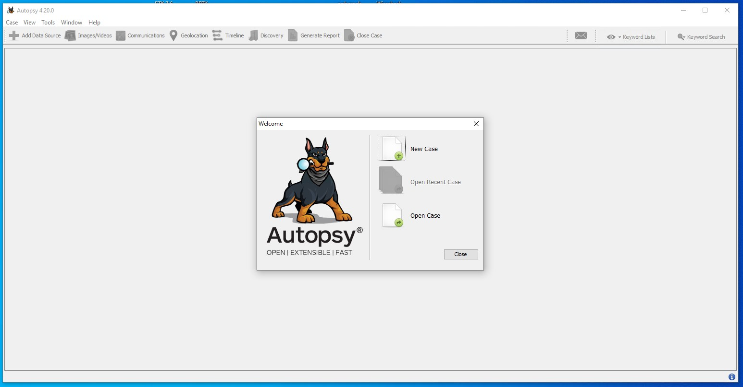
Notes:
1) Open Autopsy

Slide 13
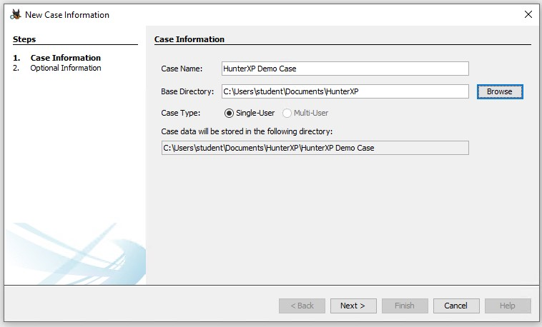
Notes:
2) Creating a new case for Hunter XP

Slide 14
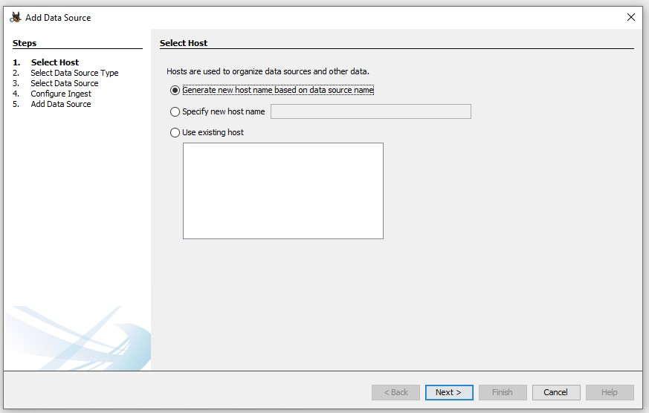
Notes:
3) Generate new host name

Slide 15
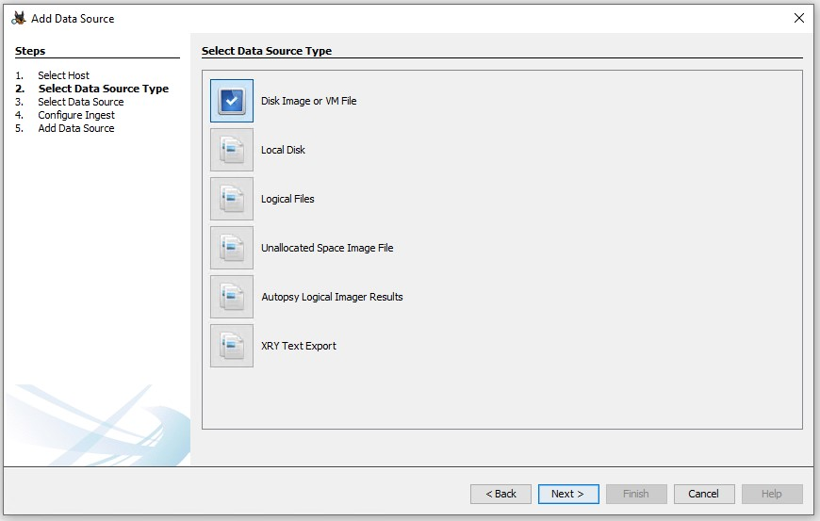
Notes:
4) Data source is a disk image

Slide 16
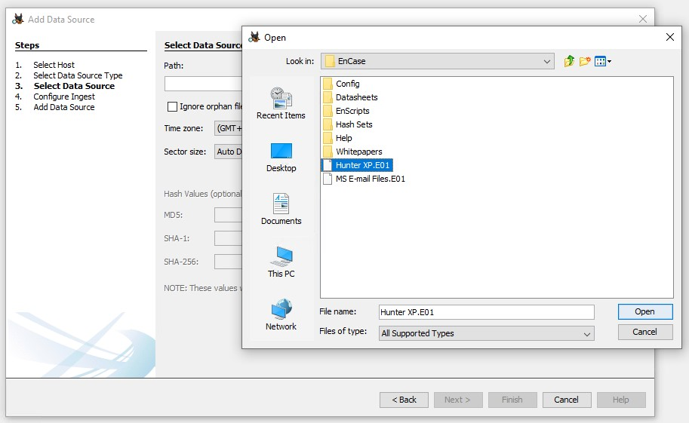
Notes:
5) Locate and load the Hunter XP image – note its location may not be identical to this screenshot depending on how the session has been prepared for your students.

Slide 17
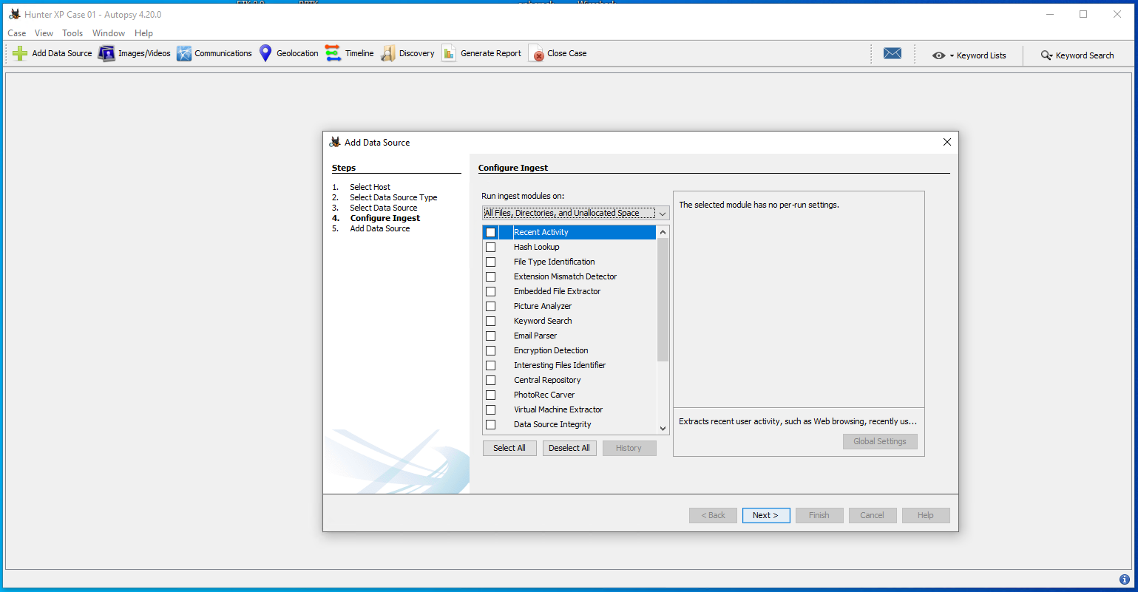
Notes:
6) Deselect all of the ingestion modules if they are selected.

Slide 18
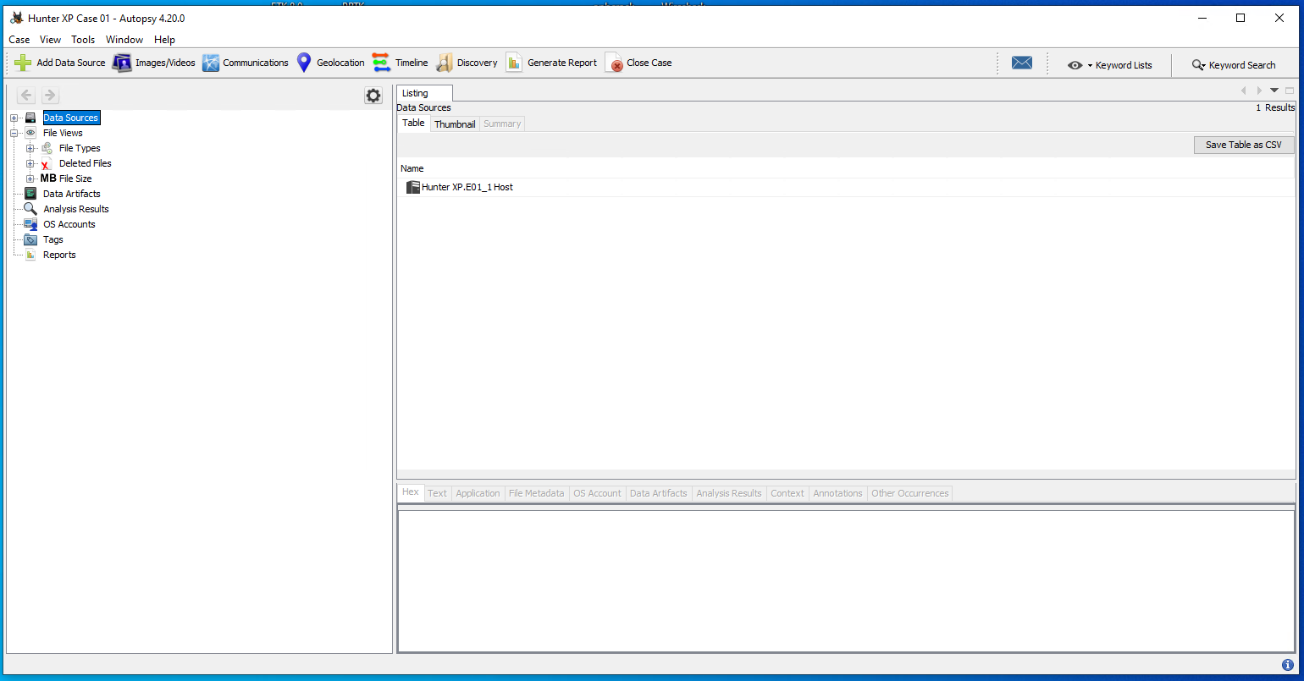
Notes:
7) Case setup has been successful and students can start exploring the results.

Slide 19
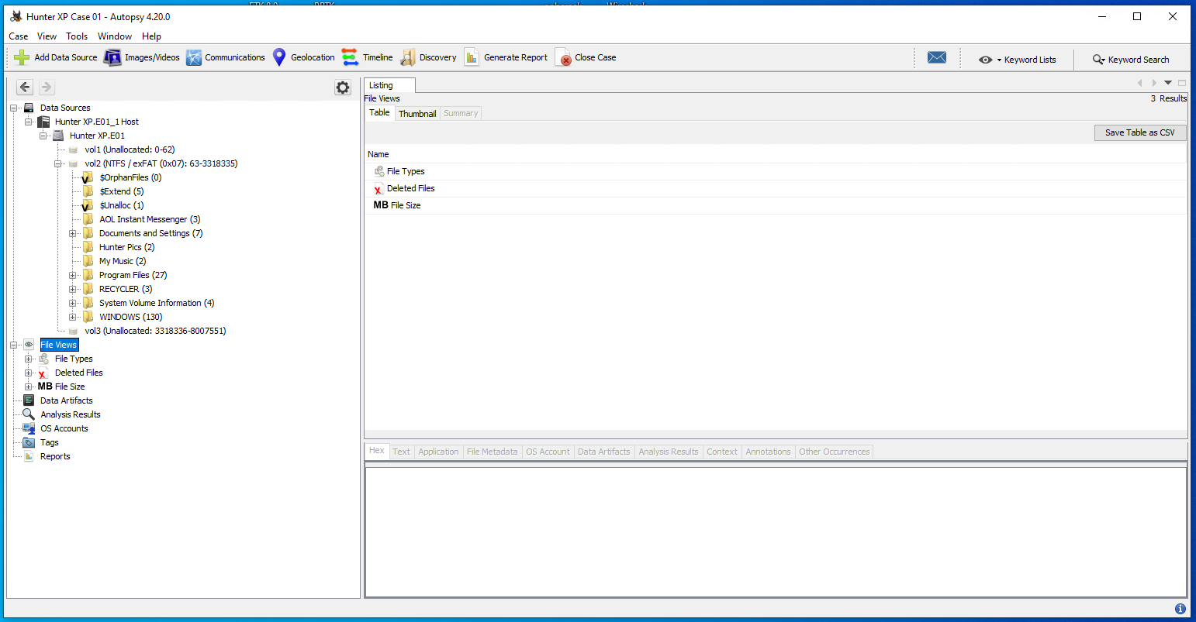
Notes:
8) If we look at the allocated file space, we can see the file system for a Windows installation.

Slide 20
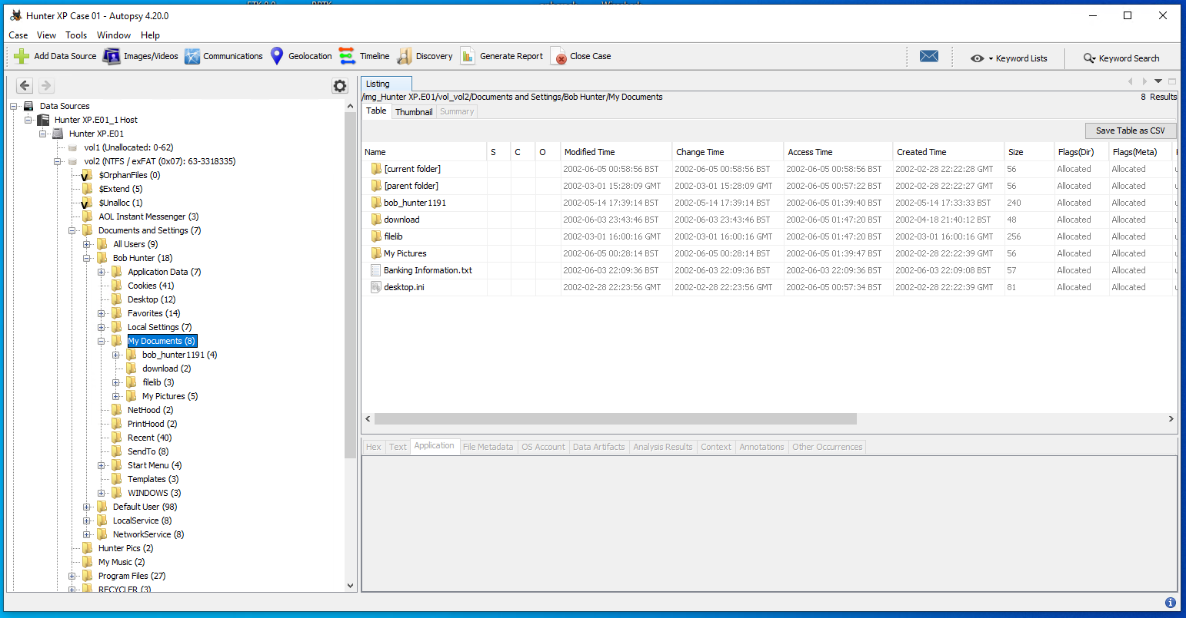
Notes:
9) We can start to explore the detected file system, such as having a look in the my documents area.

Slide 21
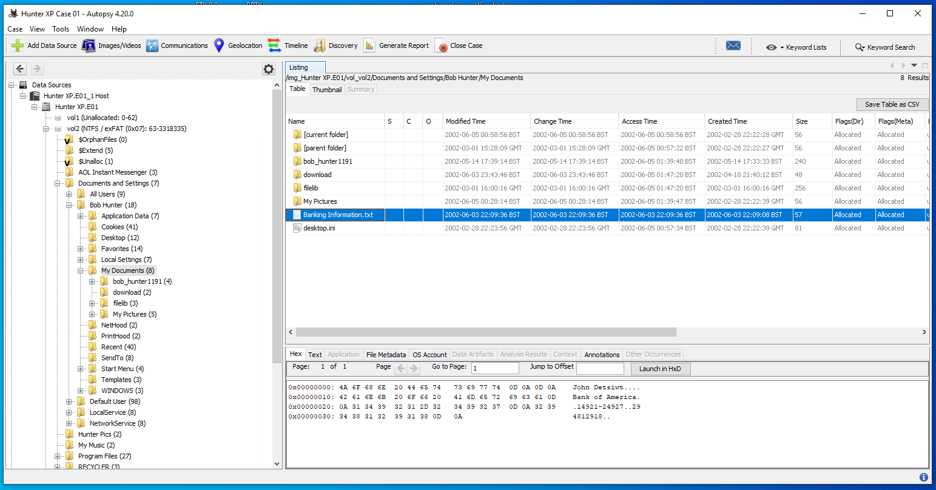
Notes:
10) Perhaps this banking information file means something ?

Slide 22
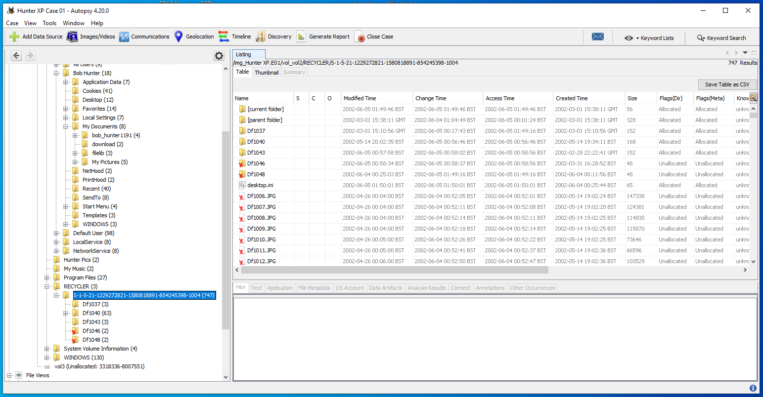
Notes:
11) We can also have a look at the recycle bin – we can see that the most recent user appears to have deleted some images.

Slide 23
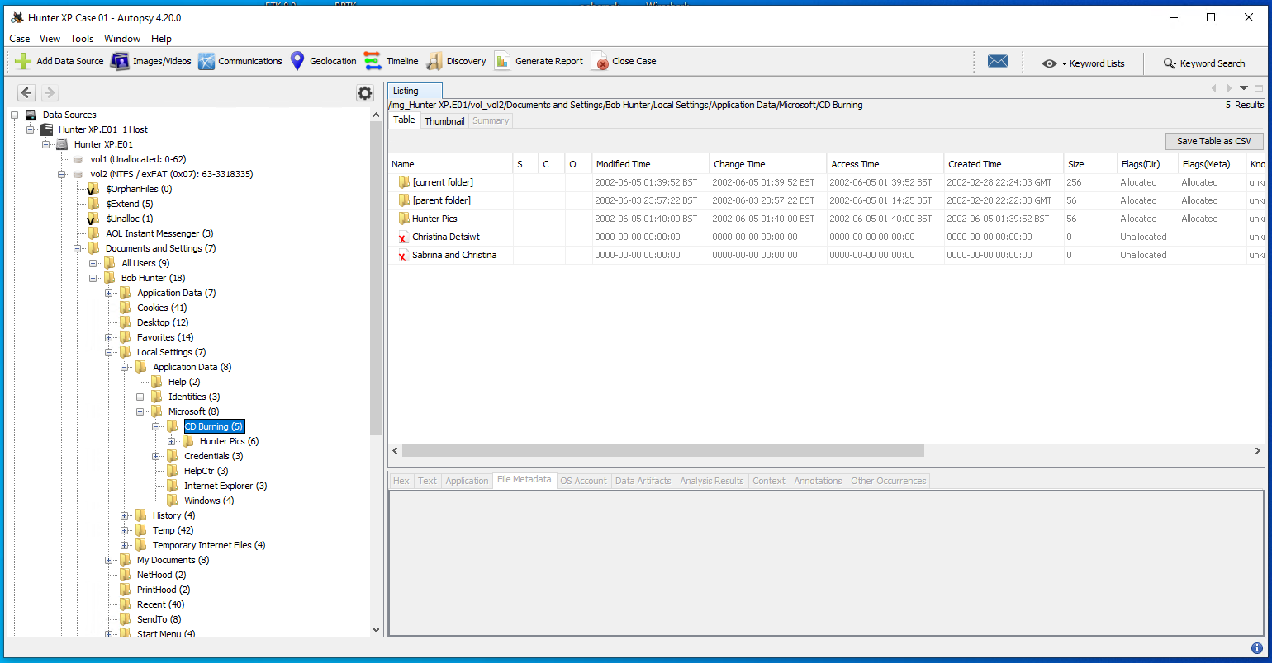
Notes:
12) With this version of Windows (Windows XP) we can check to see the most recent files burnt to a CD. In this case, we can see that the suspect loaded some of those deleted photographs onto a CD.

Slide 24
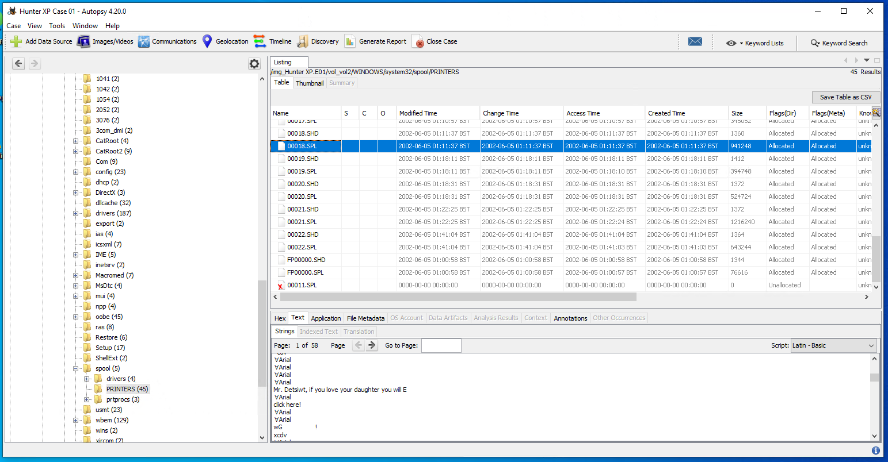
Notes:
13) If we have a look at the printing history of this Windows installation, we can find some clues that could potentially be evidence of a crime having been committed.
What other evidence can be found in the printing history?

Slide 25
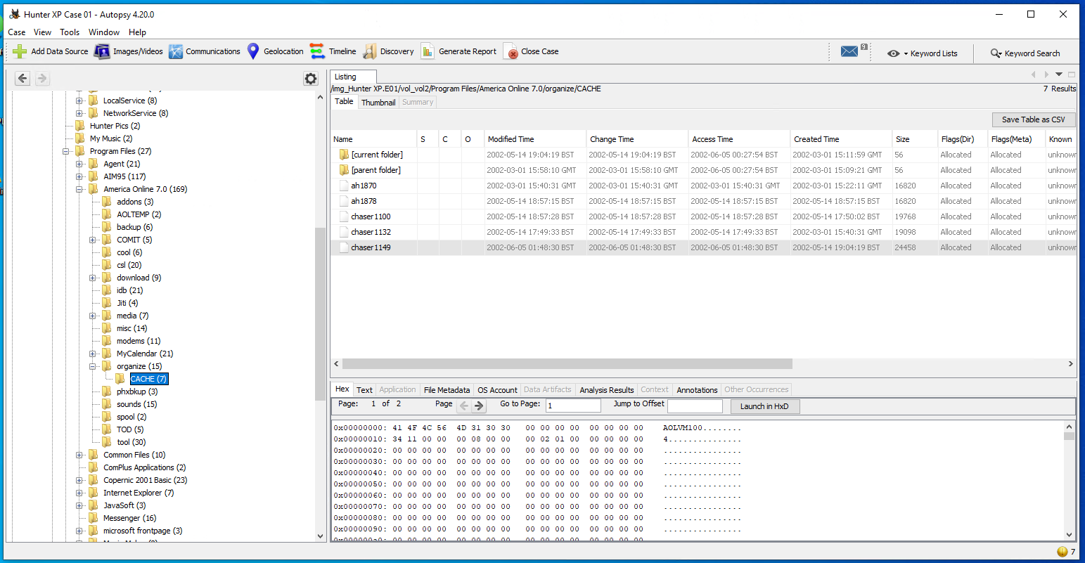
Notes:
14) We can also have a look at specific application history, such as emails or instant messaging – what can we get if we run some data carving modules on these types of files?

Slide 26
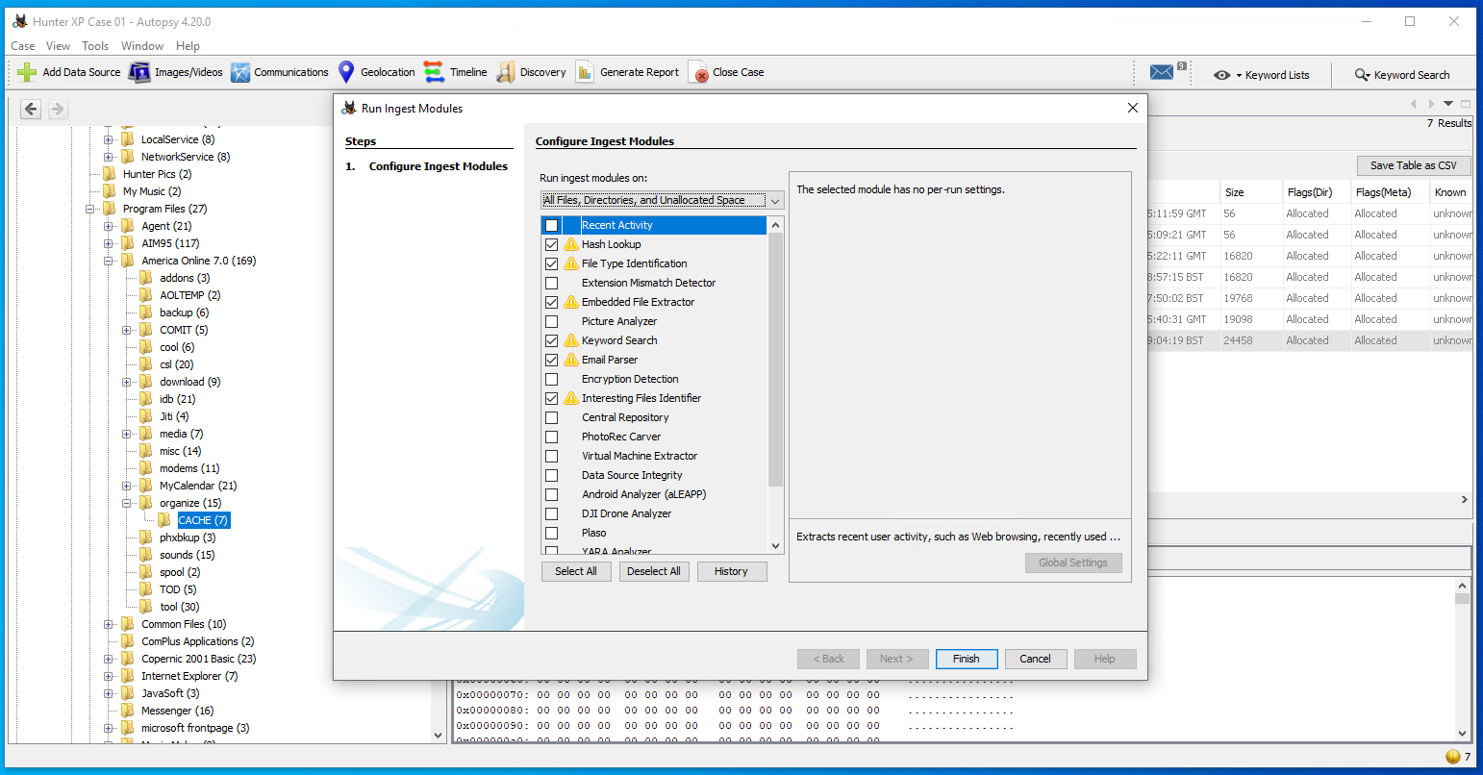
Notes:
15) Try running the selected ingestion modules (note that the yellow triangle will only show up if you have already ran these modules).

Slide 27
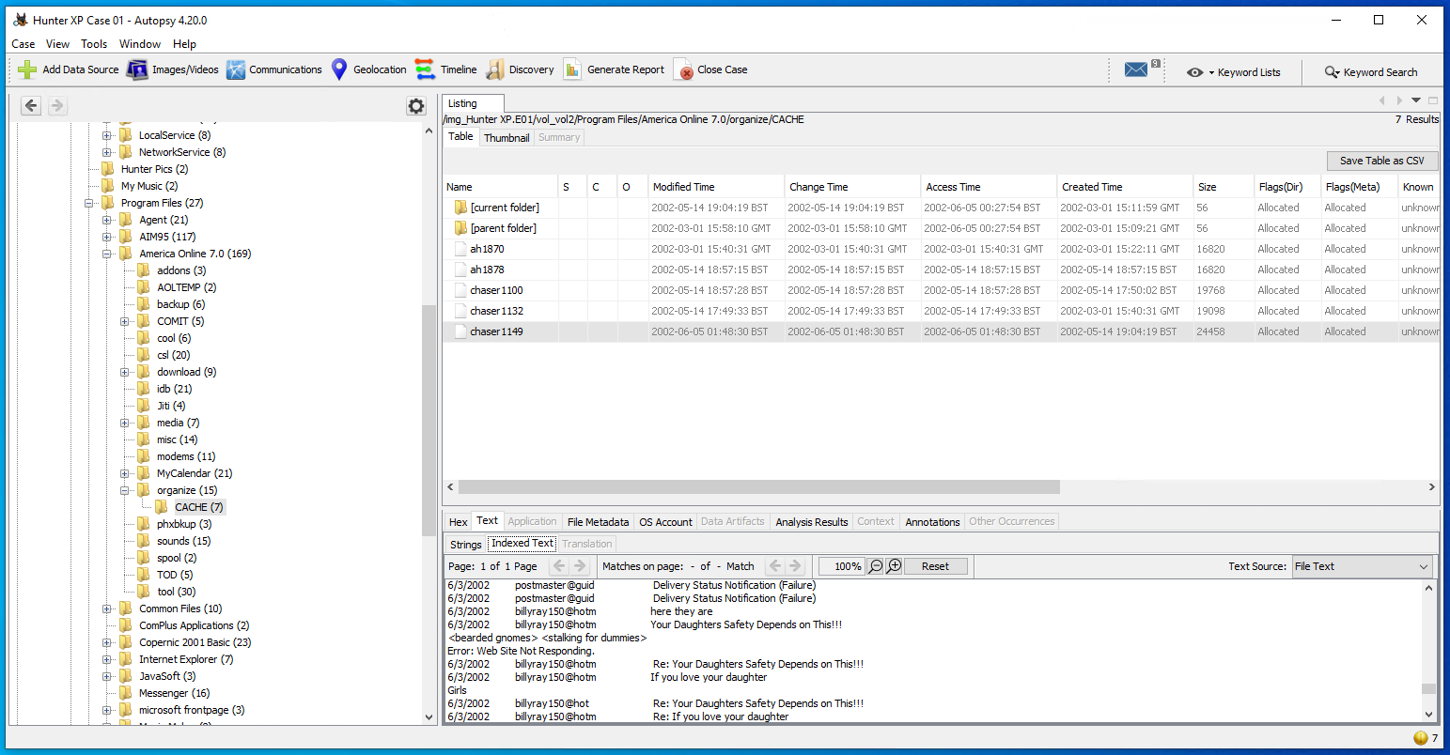
Notes:
16) After running those modules, checking the indexed text for history on this America Online account shows us some concerning subject lines in the users history.

Slide 28
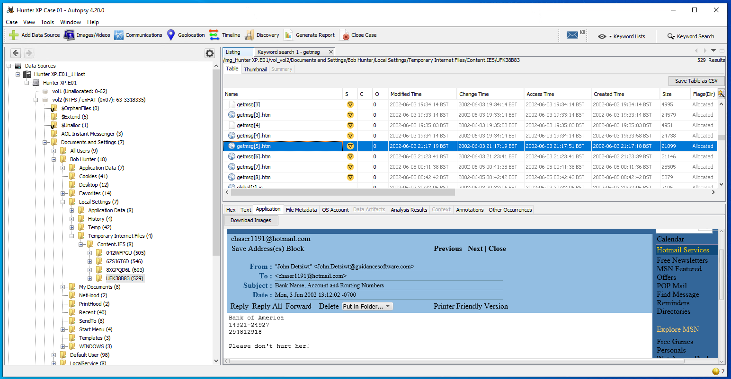
Notes:
17) With those ingestion modules having been run, we can also have a look and see what we can find from internet history. There’s certainly some concerning content in here.

Slide 29
Documenting findings
The suspect appears to have been following two women.
The women appear to be the daughters of a man named John.
There is evidence of a threat being made regarding the safety of this woman.
The bank details suggest that a payment of some kind may have taken place.
Do you think this is enough to make a solid case?
Do you think there might be additional evidence to be found from further analysis of the disk image?

Slide 30
Anti-forensics
In scenarios where the potential criminal is aware of digital forensics, they may take steps to conceal data or prevent an investigation from being able to produce evidence.
Example forms of anti-forensics:
Encryption.
Steganography.
Artifact wiping.
With the HunterXP disk image, a surface level analysis is sufficient but deeper investigation might be necessary where anti-forensics has been enacted by the suspect.

Slide 31

Any Questions?
Thank You

